Slide 1
Vending Machine
(BackEnd)
SUBMITTED BY-
Shashank Verma-RA1811027010050

Slide 2
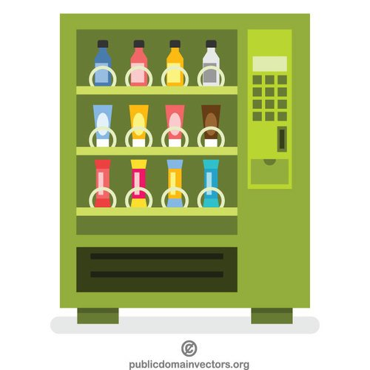
WHAT IS IT ABOUT?
We are provided with a task of designing a Vending Machine which accepts certain coins and contains certain products(eg. Coke ,Pepsi, etc). We need to design a proper backend for the Vending machine and Cover the maximum number of scenarios possible, with the help of a clean code.

Slide 3

OBJECTIVE
• To Design a proper backend for a Vending Machine with a proper Database and REST API.
• The Vending Machine should accept the coins of Rs. 1,5,10 and 25,.
• Three Products Need to be registered as current stock.
• A Proper Database needs to be created to store the history of each and every transaction and to store other useful information.

Slide 4

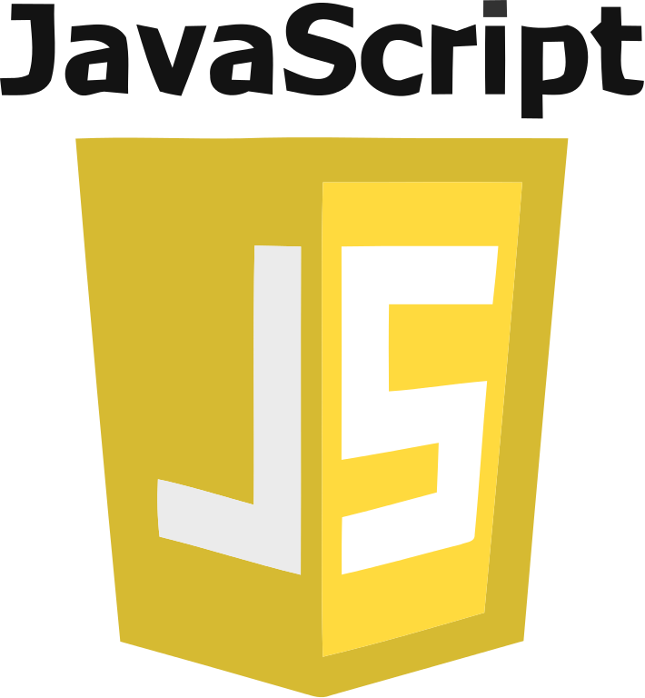

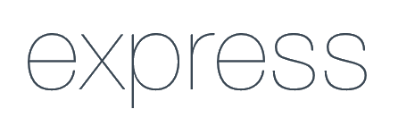
REQUIREMENTS AND TECH STACK USED
The project is developed in a Node.JS environment.
The Database used here is MongoDB, which is a non-structured Database and we will use MongoDB-Atlas as our cloud DBMS.
We’ll be needing the help of Postman application to test out the possible endpoints of the API for all scenarios.
Packages like config,express,mongoose,nodemon, etc.

Slide 5
DESIGN AND WORKFLOW
Give money back
Start
stop
N
Enter coins
Add extra money?
Add Extra Coins
Y
Select Drink
Stop
Stop
N
Give money back
Calculate total price and total change
Dispense Drinks and change
Is available
Is amount enough?
Y
no
yes

Slide 6
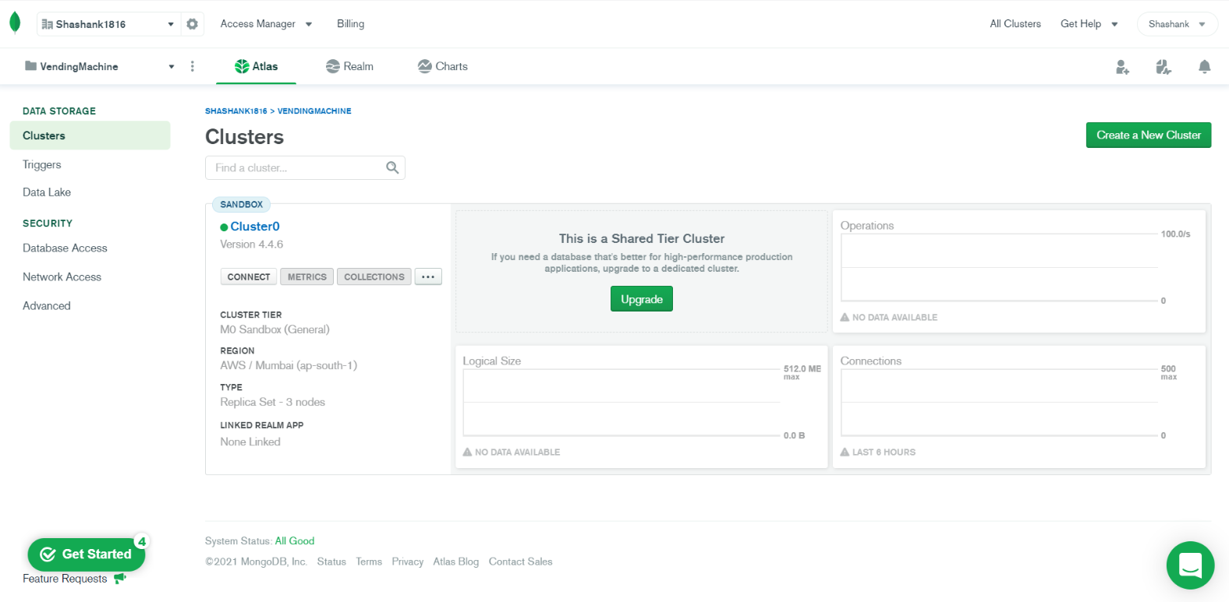
Setting Up MongoDB-Atlas

Slide 7
More About MongoDB Atlas
MongoDB atlas is a Database Management System, basically running on cloud.
It’s a Non-Structured DBMS.
It provides 2 things: -
Mongo URI (This will direct our backend to Cloud Address)
Mongo URI has 3 parts:-
i)Database name
ii)Password
iii)Username
MongoDB has 3 layered hierarchical Structure:-
DB -> Collection(s) -> Data Entries.
We’ll need a package called Mongoose to interact with MongoDB in our Node.JS project.

Slide 8
Let’s Open Postman and test all our EndPoints!

